Slide 1

NIST Special Publication 800-76, Biometric Data Specification for Personal Identity Verification
Gabriel A. Hurtado

Slide 2
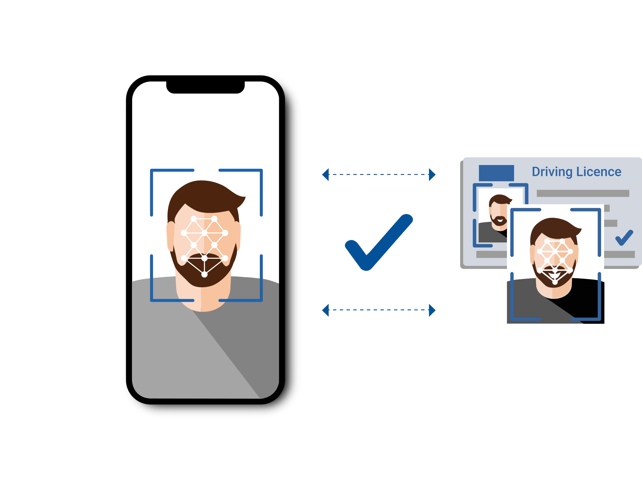
Introduction
In the realm of information security, biometric verification has increasingly become a cornerstone for ensuring that access to sensitive information and systems is strictly controlled. The National Institute of Standards and Technology (NIST) Special Publication 800-76 provides a comprehensive framework for integrating biometric data into Personal Identity Verification (PIV) systems. This presentation aims to explore how these guidelines can be effectively translated into a robust INFOSEC implementation plan, focusing on a pragmatic approach to enhancing security within our organization.

Slide 3
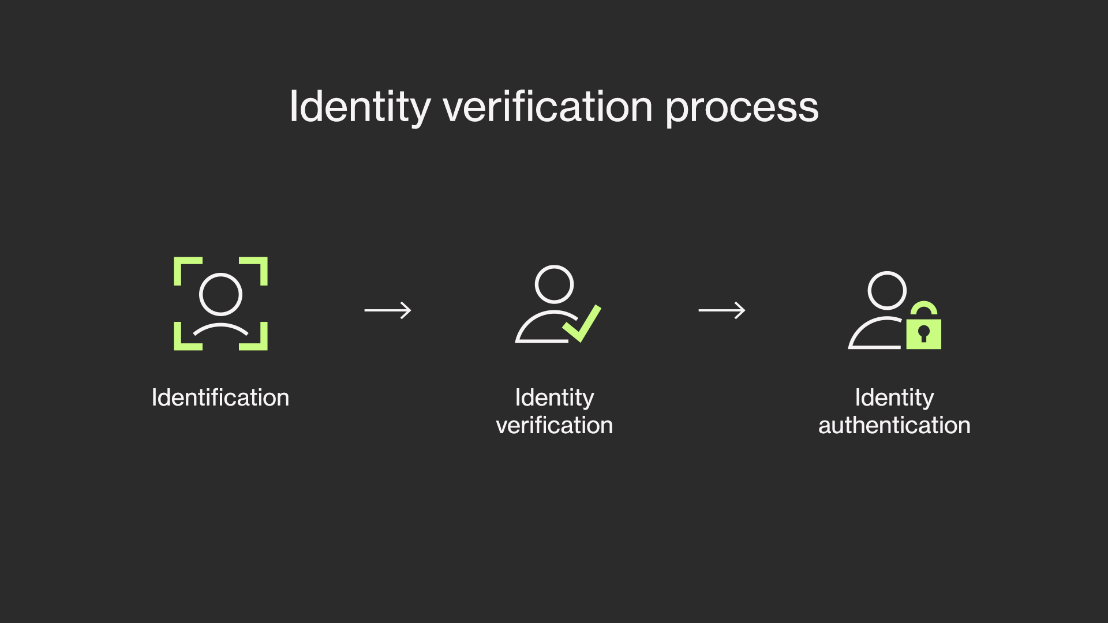

Purpose
The primary purpose of this implementation plan is to deploy a biometric security system that adheres to NIST SP 800-76 standards, aiming to fortify our organizational defenses against unauthorized access to physical and digital domains. By integrating biometric data into our existing security protocols, we can add an additional layer of sophistication and reliability, thereby reducing potential security breaches and enhancing overall system integrity.

Slide 4

Problem
Current security measures within our organization rely heavily on traditional methods such as passwords and physical tokens. These systems, while effective to a degree, are susceptible to various security threats including phishing, token duplication, and password theft. The inherent limitations of these security measures necessitate a more foolproof solution that minimizes human error and increases the difficulty of unauthorized access.

Slide 5
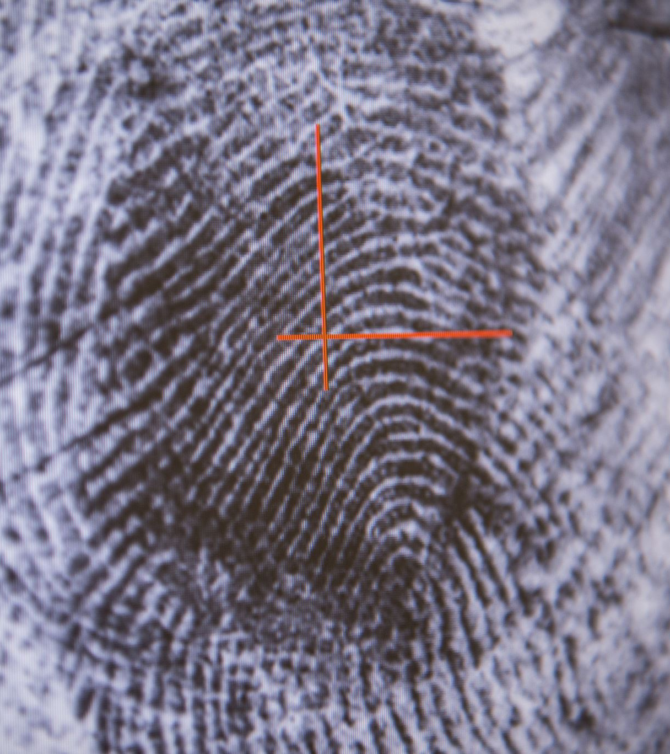
Proposed Solution based on SP or FIPS
According to NIST SP 800-76, the incorporation of biometrics for identity verification proposes a dual-factor authentication system where physical traits (e.g., fingerprints, iris patterns) are used alongside traditional security credentials. This proposal advocates for the deployment of a biometric system that includes fingerprint and iris scanning technology to create a layered security environment, as recommended by the Federal Information Processing Standards (FIPS).

Slide 6
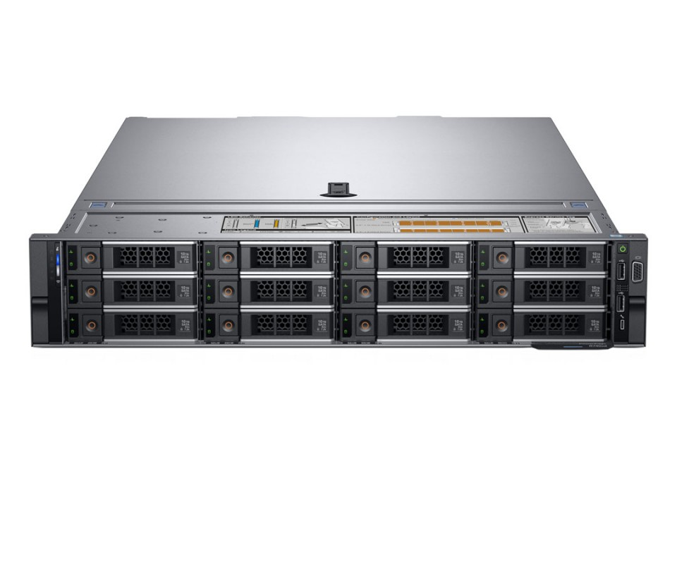
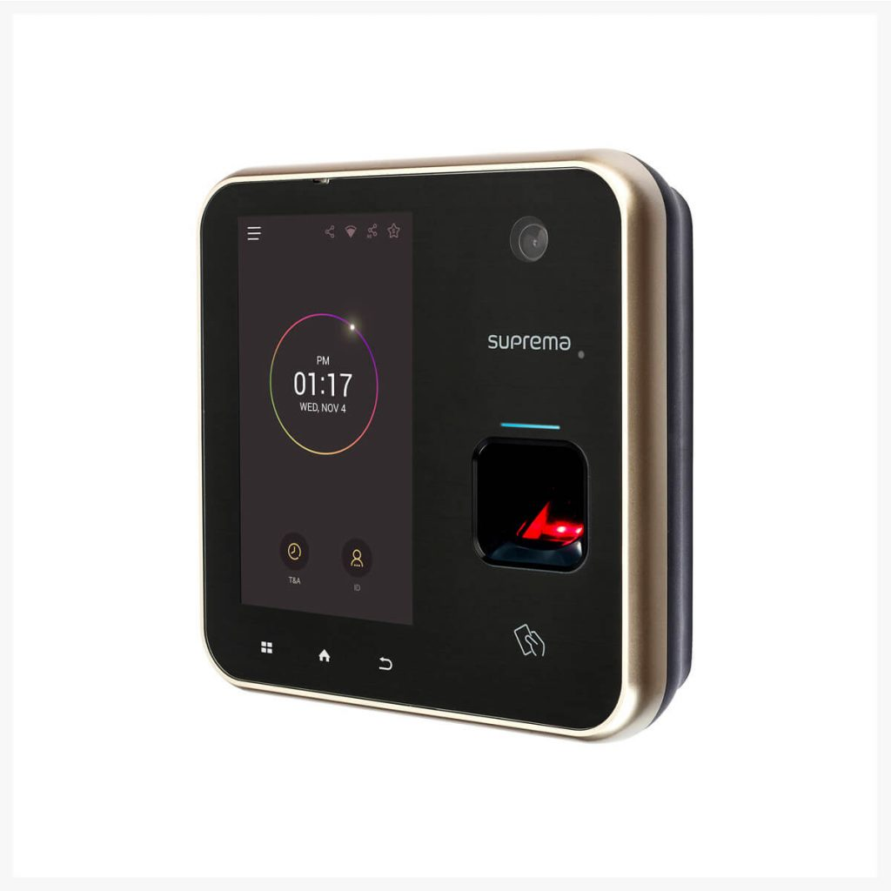
Requisitioned Equipment and/or Personnel
Implementing a biometric security system will require specific equipment and specialized personnel:
Biometric Scanners: We will use the Suprema BioStation A2 for fingerprint scanning and the Iris ID iCAM7S series for iris recognition. Both are industry leaders in speed and accuracy, essential for high-security environments.
Servers: Dell PowerEdge R740 servers will be used for secure data storage. These servers offer high performance and expandability, suitable for handling large volumes of biometric data.
Integration Software: Crossmatch DigitalPersona software will be used to integrate biometric data with our existing security systems. This software is known for its versatility across different hardware and operating systems.
Personnel:
IT Security Specialists: At least two specialists with experience in biometric system management will be hired. Qualifications include certifications in cybersecurity and prior experience with biometric technologies.
Support Staff: Additional personnel for ongoing maintenance, troubleshooting, and user support will be employed to ensure system reliability and user satisfaction.

Slide 7

Tentative Implementation Timeline
The deployment of the biometric system will be phased:
Phase 1 (0-3 months): Procurement of technology and hiring of personnel.
Phase 2 (4-6 months): System installation and initial testing.
Phase 3 (7-12 months): Full integration with existing systems and user training.
Phase 4 (13-18 months): Operational deployment and ongoing evaluation. This timeline ensures a structured rollout that minimizes disruption to current operations while allowing adequate time for system testing and user adaptation.

Slide 8

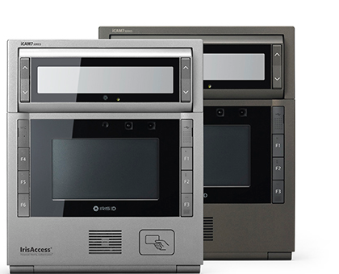
Budget
The budget for implementing the biometric security system is detailed as follows:
Biometric Scanners: $30,000 for Suprema BioStation A2 scanners and $50,000 for Iris ID .
Servers: $45,000 for three Dell PowerEdge R740 servers.
Integration Software: $15,000 for licensing and installation of Crossmatch DigitalPersona software.
Personnel Costs: $200,000 annually, including salaries for IT security specialists and support staff.
Miscellaneous Costs: $10,000 for contingencies, unforeseen issues, and additional peripherals needed for system setup.
Total Estimated Budget: $350,000

Slide 9

Evaluation System
To measure the effectiveness of the biometric system, we will implement an evaluation framework that assesses:
System reliability and error rates.
User acceptance and ease of use.
Security breach attempts and their outcomes. Metrics collected will be used to fine-tune the system continuously and to validate its efficacy against predefined benchmarks.

Slide 10
Conclusion
Adopting a biometric-based security system as per NIST SP 800-76 guidelines presents a forward-thinking approach to safeguarding sensitive information and infrastructure. This plan outlines a clear, structured pathway towards enhanced security efficacy, paving the way for a safer and more secure operational environment within our organization.

Slide 11

Benefits
The integration of biometric systems promises several benefits:
Enhanced security through hard-to-replicate authentication methods.
Decreased dependency on potentially insecure passwords and tokens.
Streamlined access procedures for employees.
Long-term cost savings through reduced security breaches and fraud incidents.

